Slide 1

JavaScript Session 4
25/09/2023
Plan and Homework

Slide 2
Agenda
Plan for next 2 week
Recap of QuerySelector + click event listener
Developing a basic notes app with JS and Bootstrap5
Github desktop
Homework assignment explanation

Slide 3
Our approach
Learn syntax
Get Certified Online
Do Projects To build portfolio
Interview Preparation
Internship with CodeMentorMU

Slide 4
Projects to-do to build a portfolio
Build with JS
10 basic apps
Todo app
Quiz app
Notes app
Quote generator
Age calculator
Weather app
OpenAPI app
More TBC
Build an e-commerce App with React and .Net Core
Build your portfolio website with Three.js and React

Slide 5
Session 3 - Recap
document.querySelector("#id");
document.querySelector(".class");
document.querySelector("name");
.addEventListener("click",(e)=>{})

Slide 6
Session 4 - Developing a notes app
Demo

Slide 7
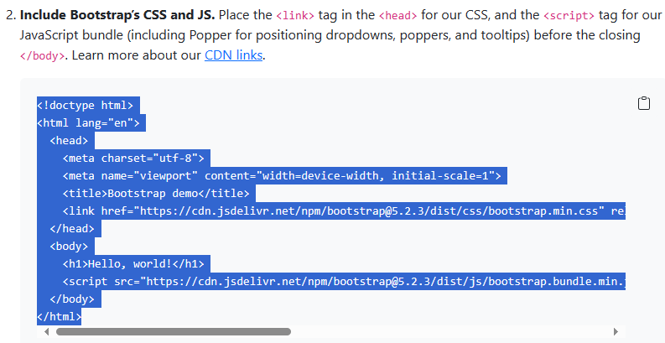
Bootstrap5 Setup
Get started with Bootstrap · Bootstrap v5.2 (getbootstrap.com)

Slide 8
Homework Assignment
JavaScript Certification – To finish in 1 Week
Front End Certification – To finish in 2 Week
Google Analytics Certification
Problem solving for interviews: HackerRank

